Slide 1


LOST AND FOUND HUMAN DETECTION
Using Siamese Nwetwork

Slide 2
Presented By
S
M
M
Sadia Islam Raida
Md Minhajul Islam
Marufur Rashid
2022537642
2021887642
2021443642

Slide 3

Abstract
“Lost and Found Human Detection” is a website developed for finding missing persons using Artificial Intelligence. There are mainly two ways of finding a missing person. With the help of Law and using social media platforms. Judging from past experiences, it is time-consuming; in most cases, the result is negative. So, we came up with the idea of finding a lost person using an Artificial Intelligence based website where people can post information about the missing person, and the website will use a face recognition system to match the lost person’s face with the found person’s faces and gives us a result whether the person is found or not by providing a match notification.

Slide 4
Introduction
Lost and Found Human Detection is a website built for locating missing persons. People can use this website to upload information and photos of their lost person, quickly search through thousands of posts, and get the result correctly by avoiding hazards related to the old traditional way. Bangladesh is an overpopulated country with a population of around 169,487,689. Thousands of people go missing every year. “Dhaka Tribune”, an online newspaper source, stated that almost 20,000 children go missing every year.Most of the cases, these missing persons become victims of trafficking and heinous crimes. Locating them fast and helping law enforcement agencies is also a motivation to create this project.

Slide 5

Background Research
The "Lost and Found Human Detection" project is a unique approach that combines elements from various existing projects. One such project is the "Human Based Lost and Found Project" in Malaysia, which allows users to post information about missing individuals and engage in live chat. However, this project lacks a face recognition system.
In contrast, the "Lost and Found Human Detection" project incorporates a face recognition system. Users can upload images of missing individuals, which are stored in a zipped file. This file is then processed by a Siamese Network's trained model in a collaborative environment (such as Google Colab). The model matches the faces and provides instant notifications along with accuracy percentages.
Overall, the "Lost and Found Human Detection" project combines the strengths of these different approaches to create a comprehensive solution for identifying missing individuals using face recognition technology.

Slide 6
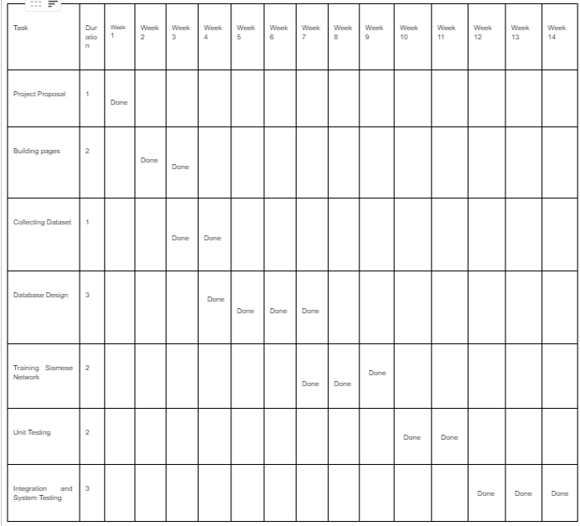
GANTT CHART

Slide 7
TOOLS USED
HTML
01
CSS
02
DJANGO
03
PYTHON
07
SQLITE
04
TENSRO FLOW
05
SIAMESE NETWORK
06

Slide 8
IMPLEMENTATION
STEPS
Front-End
Back-End
Dataset
HTML,CSS,JavaScript
Django,SQLite
Kaggle

Slide 9
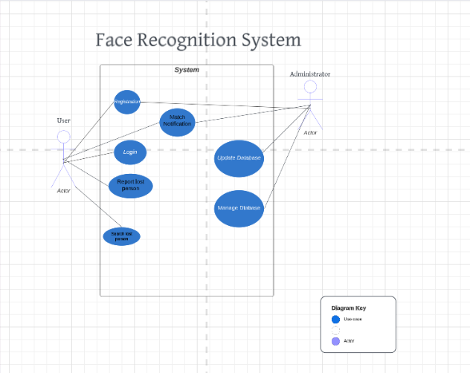
USE CASE DIAGRAM

Slide 10
PROJECT DESCRIPTION
LOGIN /REGISTRATION
SEARCH CAPABILITY
FACE RECOGNITION
MATCH NOTIFICATION
SECURITY
USER EDIT

Slide 11
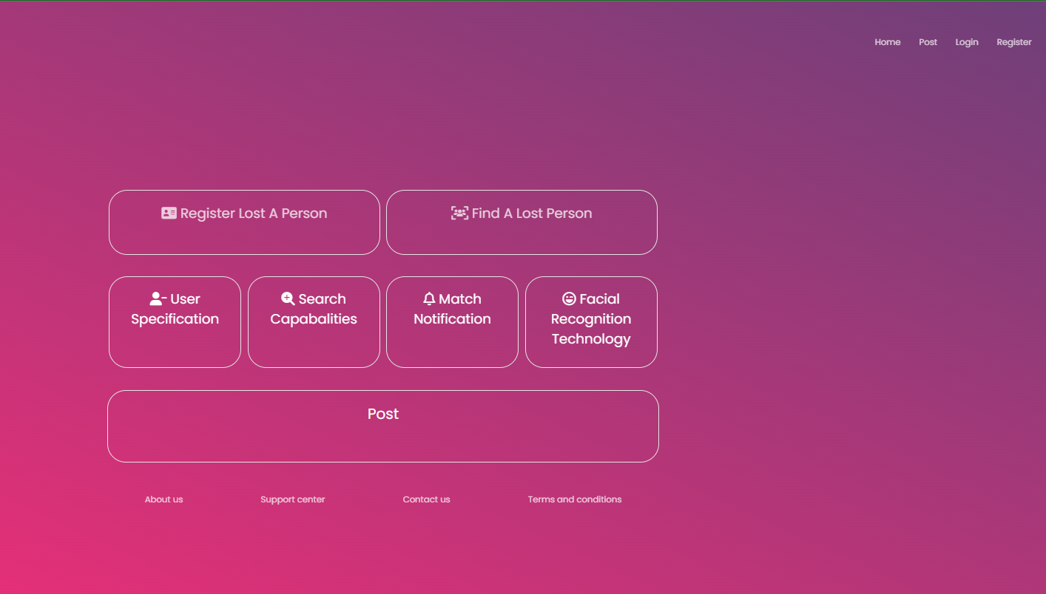
HOME PAGE

Slide 12
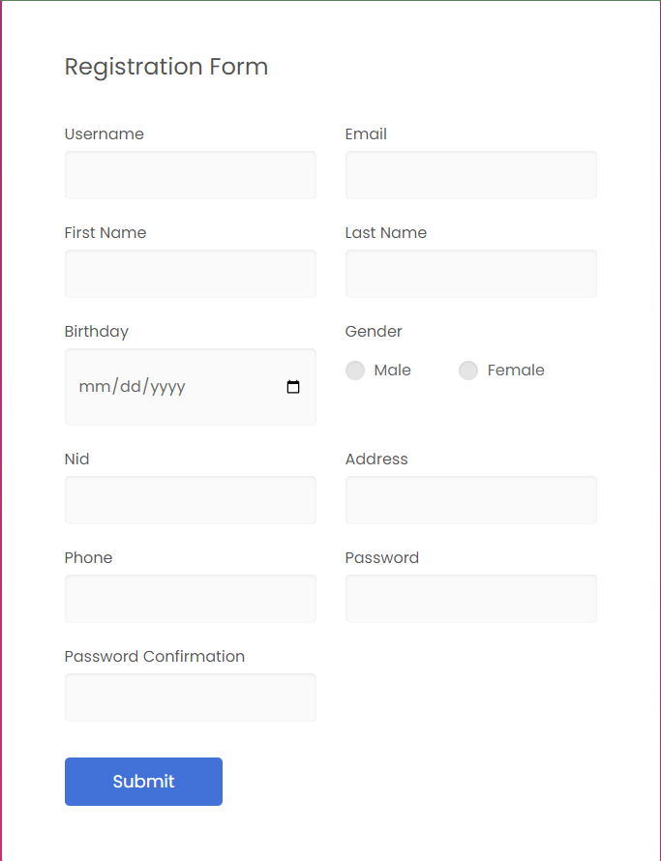
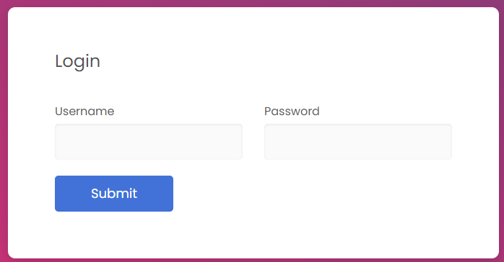
REGISTRATION & LOGIN FORM

Slide 13
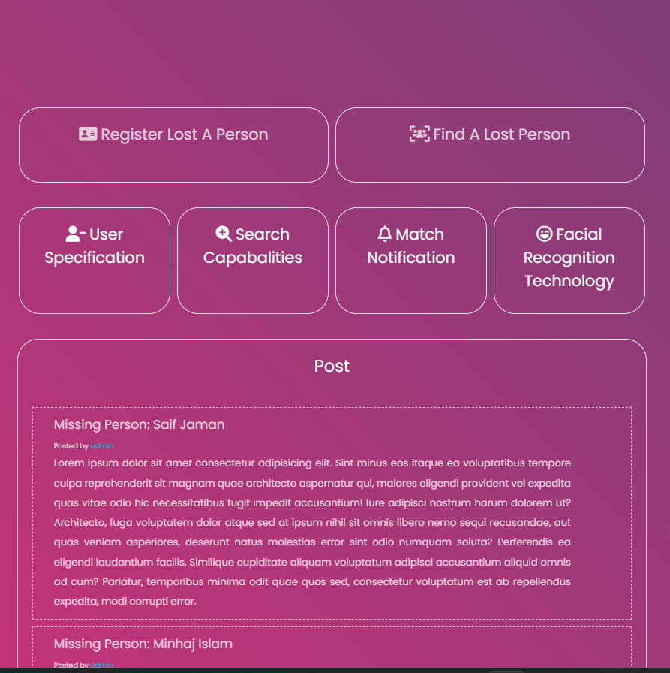
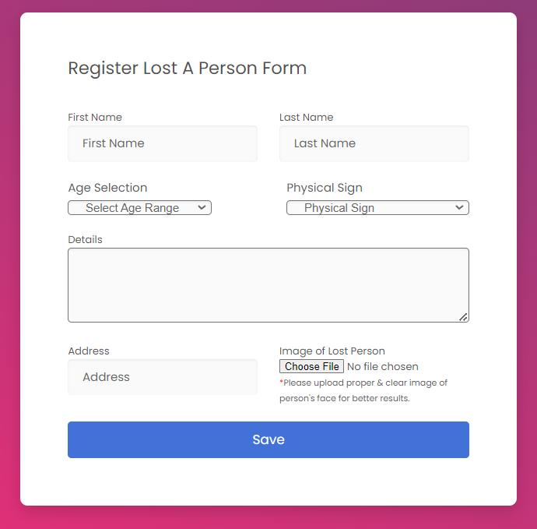
AFTER LOGIN & POST ABOUT A PERSON FORM

Slide 14
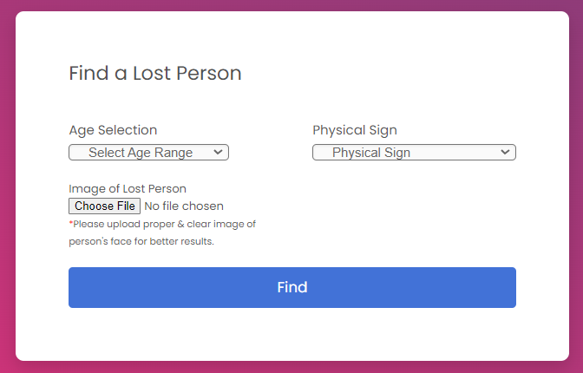
FIND A PERSON PAGE

Slide 15
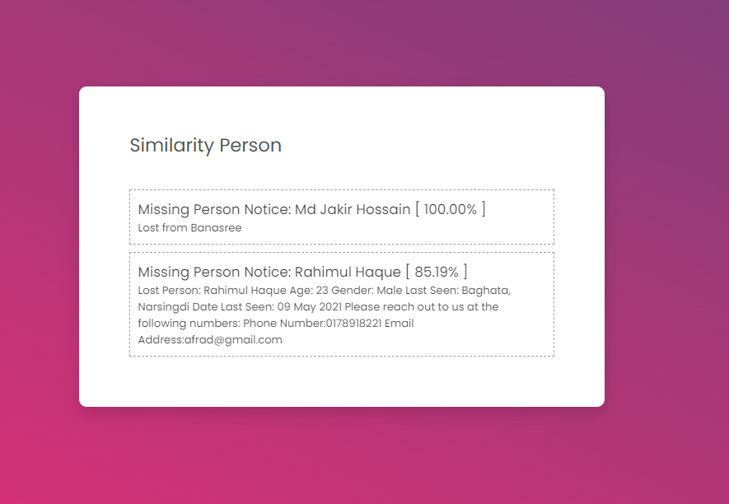
RESULT

Slide 16
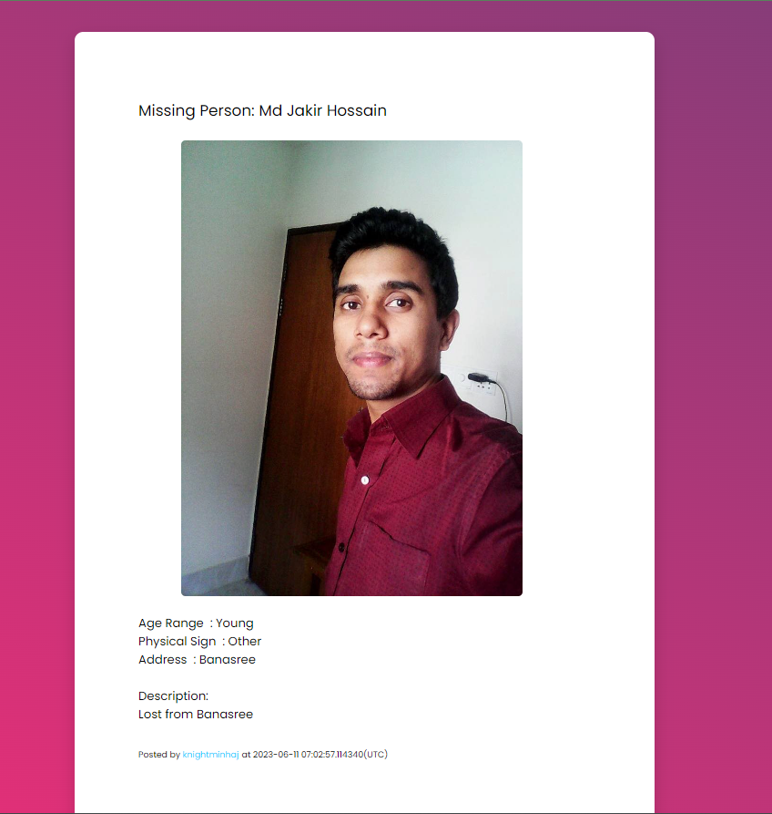

INFORMATION ABOUT THE MATCHED PERSON
USER BUTTON

Slide 17
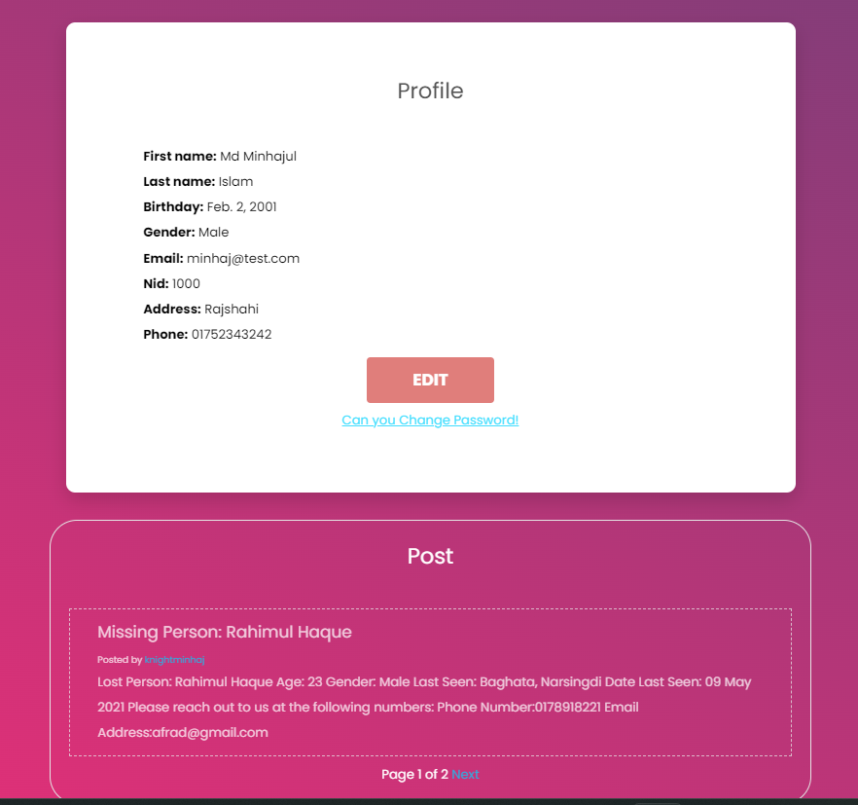
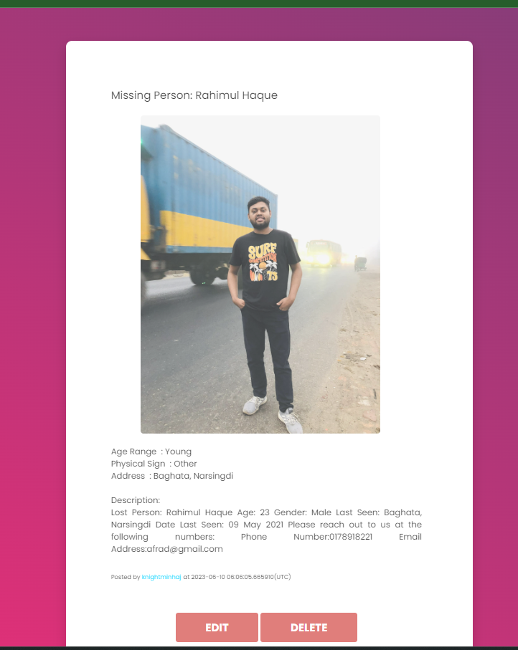
USER EDIT PAGE

Slide 18
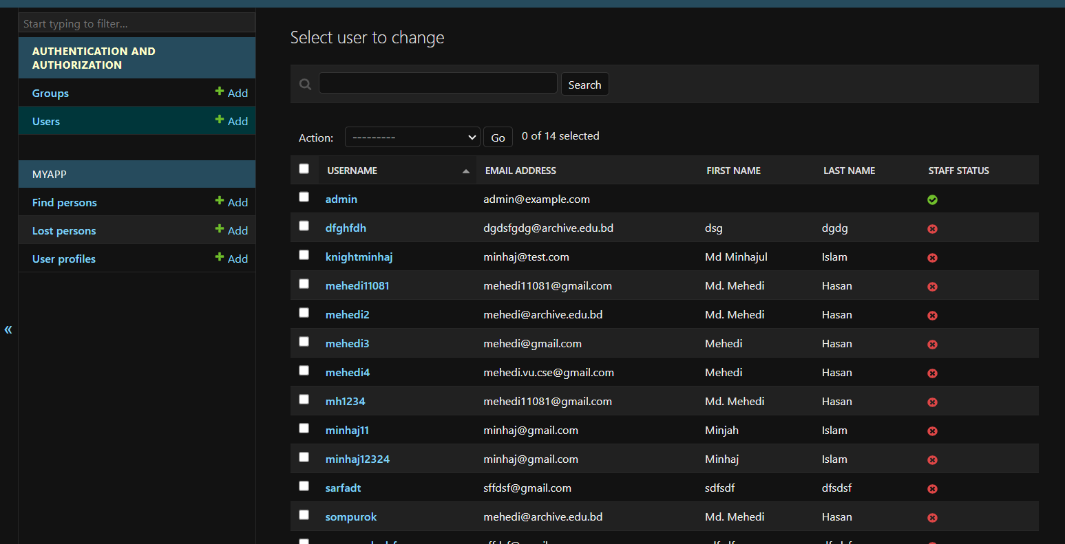
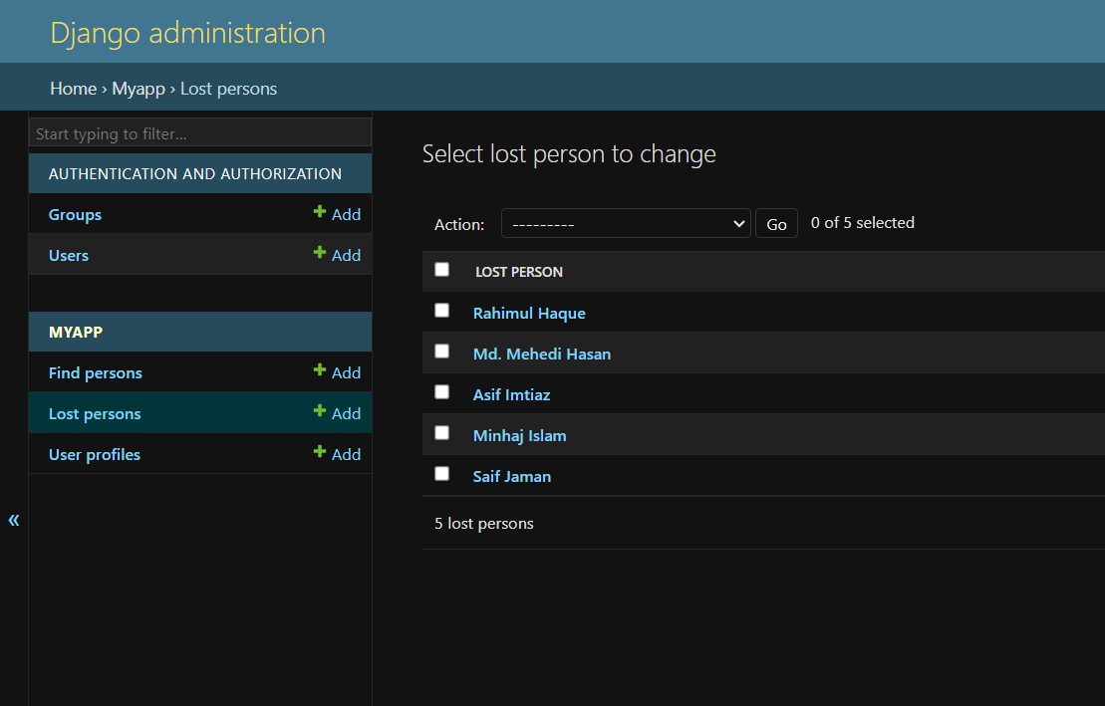
USER DATABASE LOST PERSON DATABASE

Slide 19
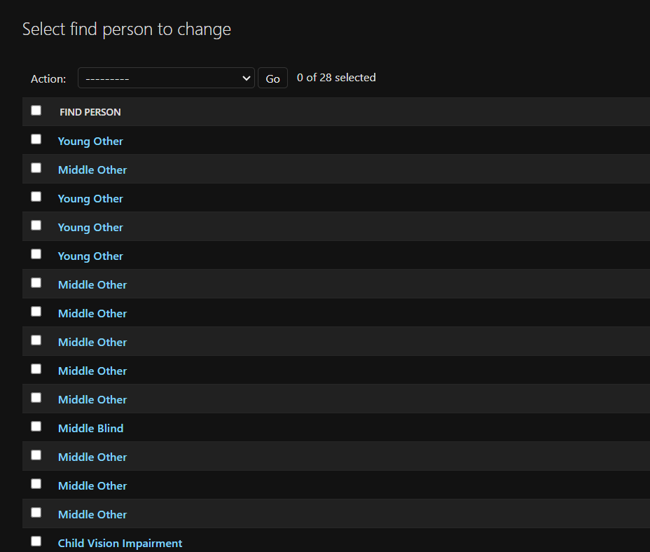
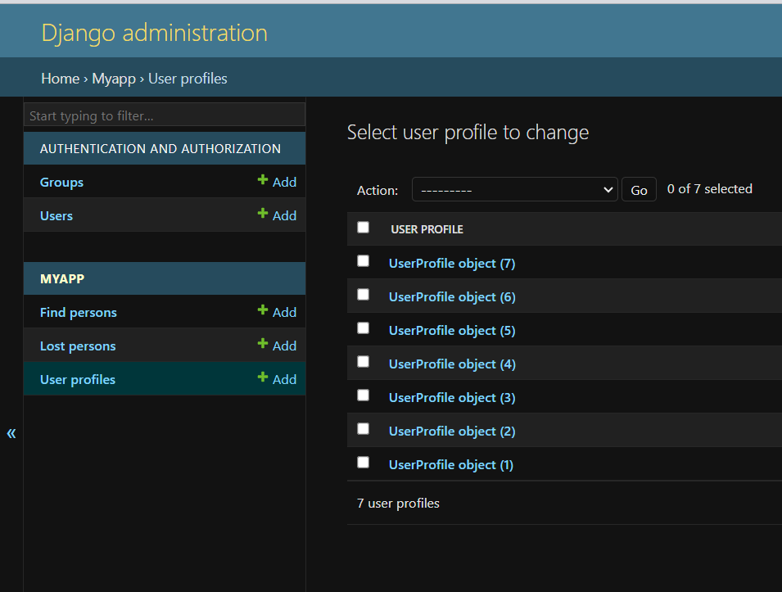
FIND A PERSON DATABASE USER EDIT DATABASE

Slide 20
Project Summary
In Bangladesh, people are nowadays being driven to use not just only social media platforms for entertainment but also using online platforms for other uses. But this one is relevantly new, and if we can connect our website with Law Enforcement.
Technical Issues and Solutions:
Dataset of Siamese Network
Enormous Bugs
Creating several paths

Slide 21
Conclusion
“Lost and Found Human Detection” is a website built for reuniting people with their loved ones. We used face recognition for matching faces stored in our system with the images posted. It is a significant project because it is free of cost, easy to use, great aid to the Law Enforcement agencies, and reduces criminal activity by locating missing persons as they could have been victims of trafficking and other heinous crimes.

Slide 22
Thank you

